Slide 1
AIRFLOW ETL PIPELINE

Slide 2
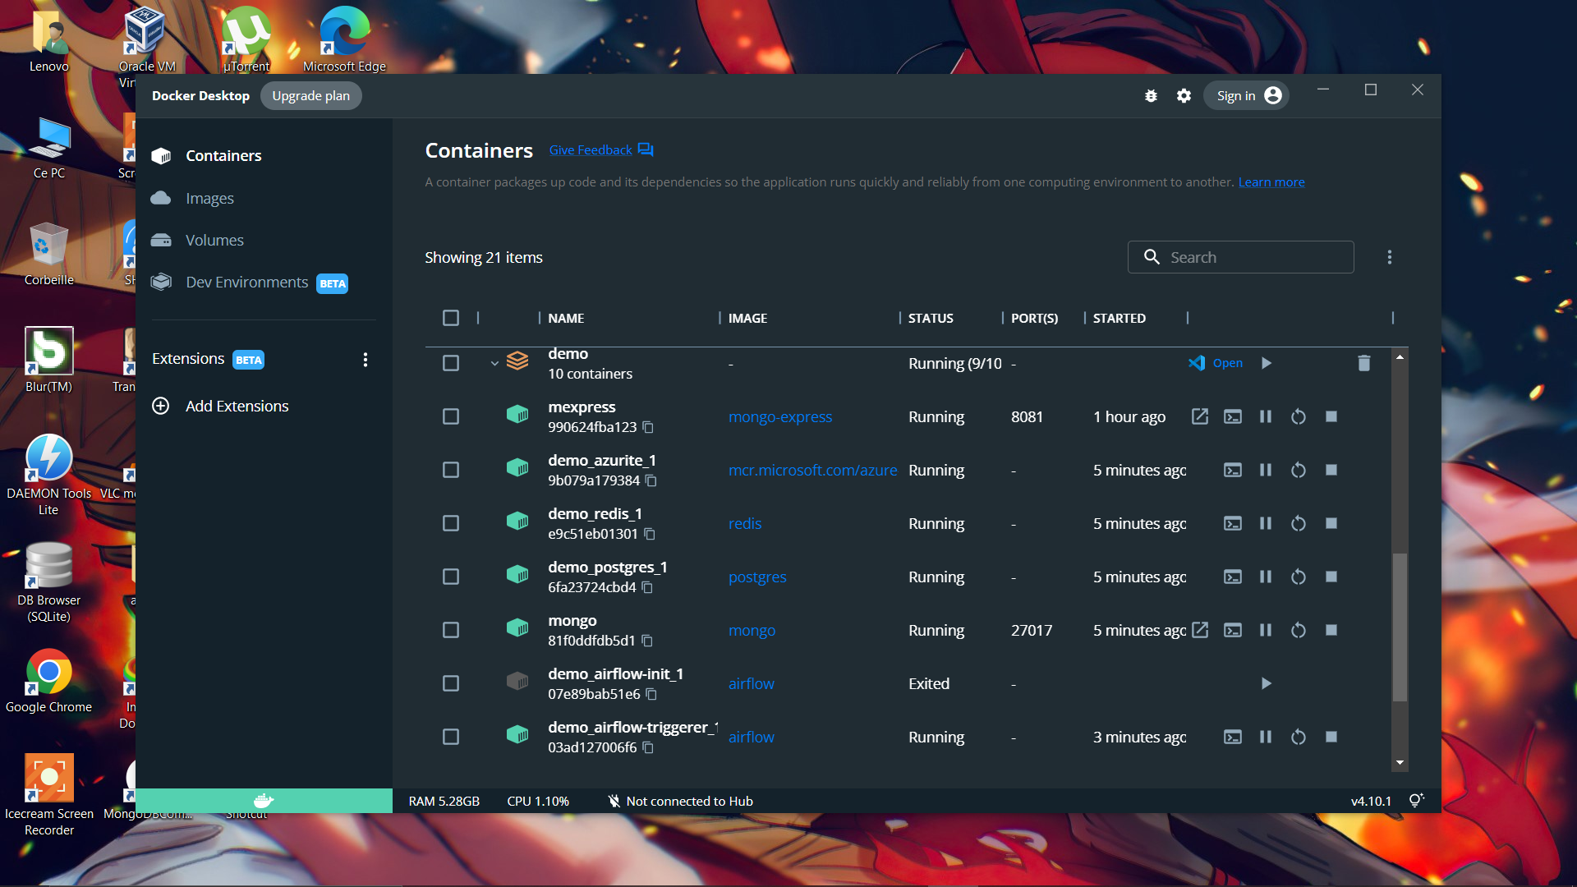
Project Containers running on docker desktop

Slide 3
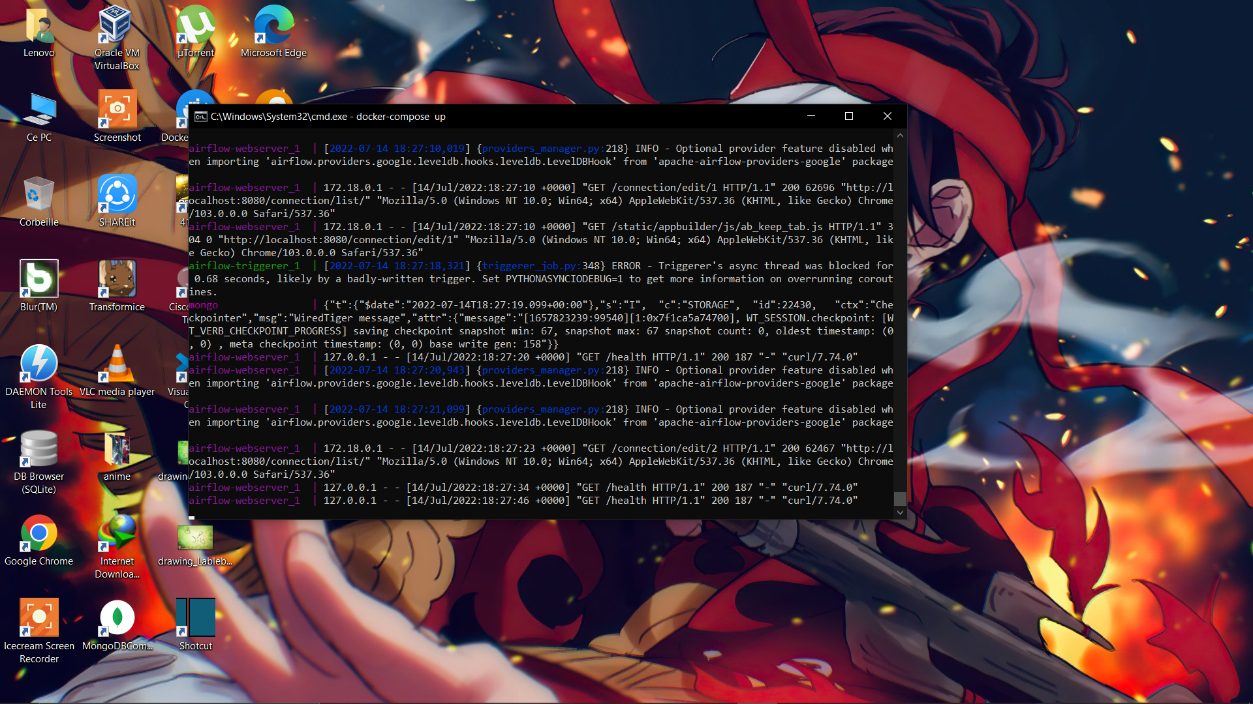
Docker-compose up command to run the project

Slide 4
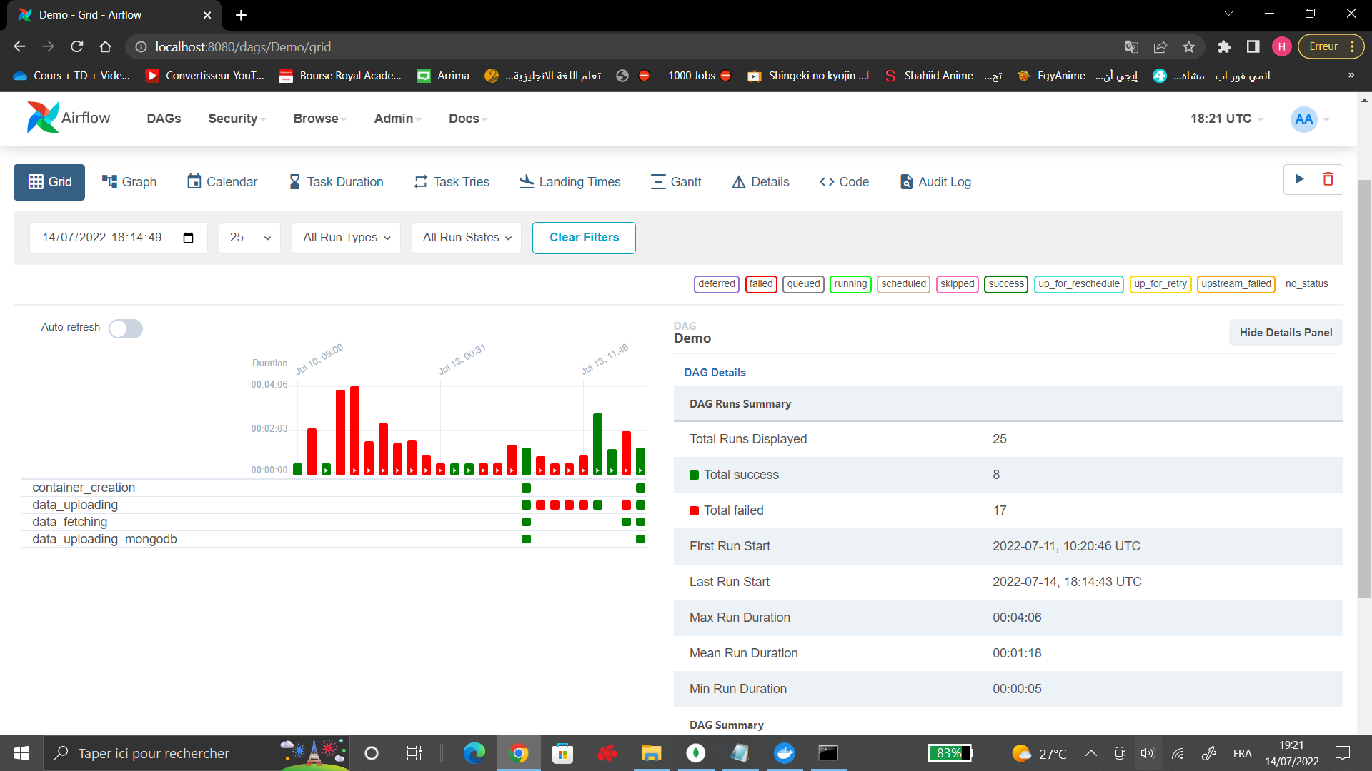
A general looking of the pipeline on Airflow UI

Slide 5
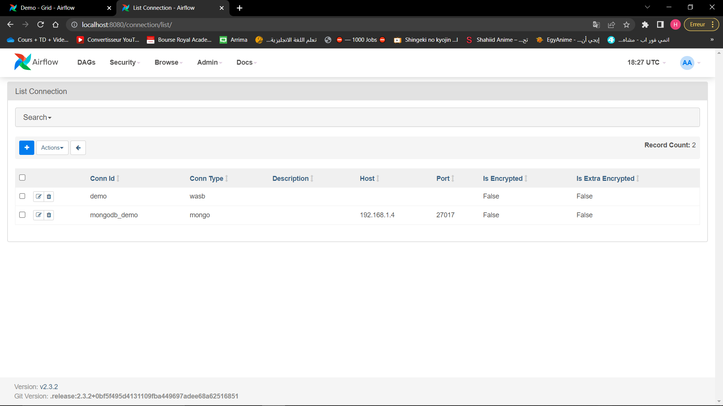
Connections List: azure and mongodb connections

Slide 6
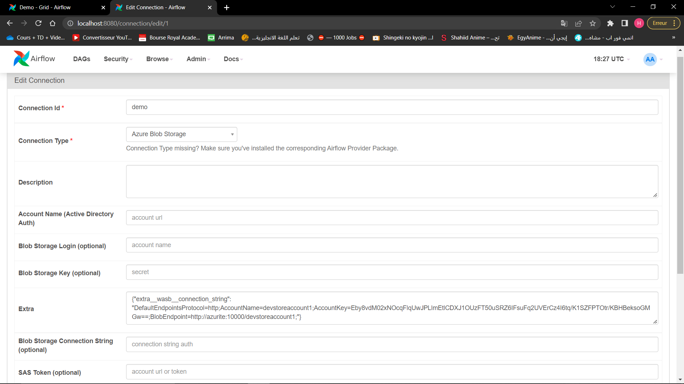
Azure Blob Storage connection configuration

Slide 7
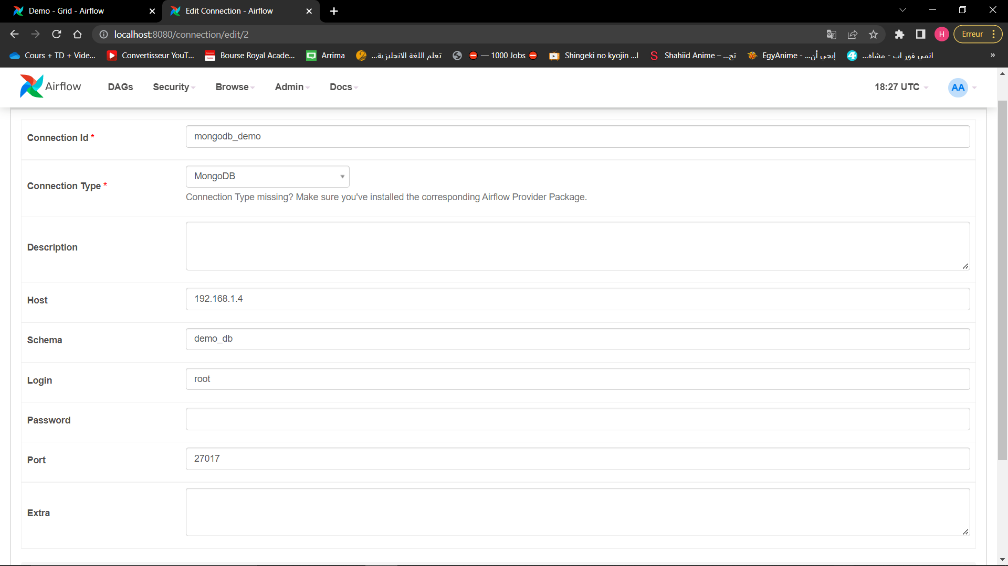
Mongodb connection configuration

Slide 8
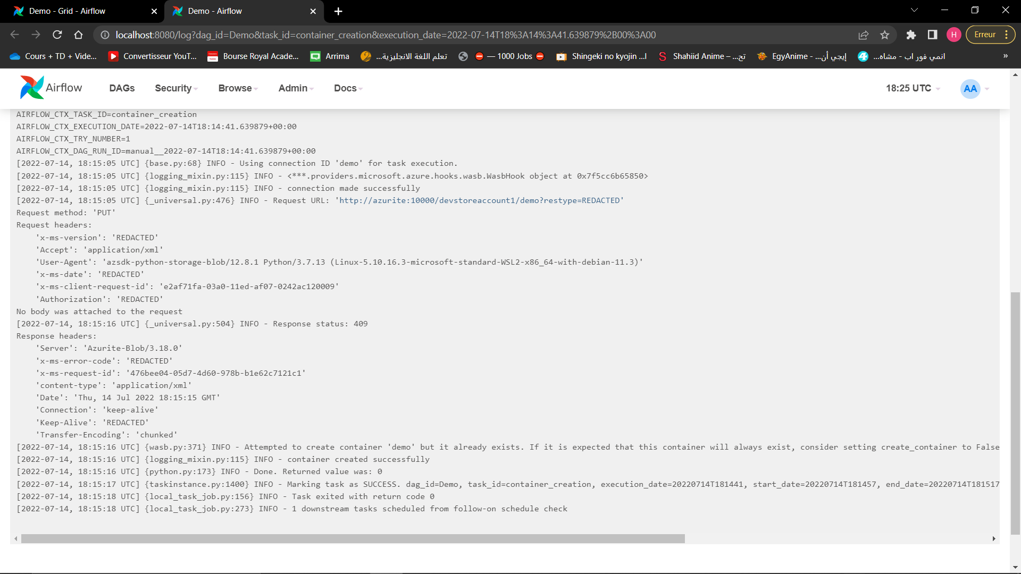
Container_creation_task output

Slide 9
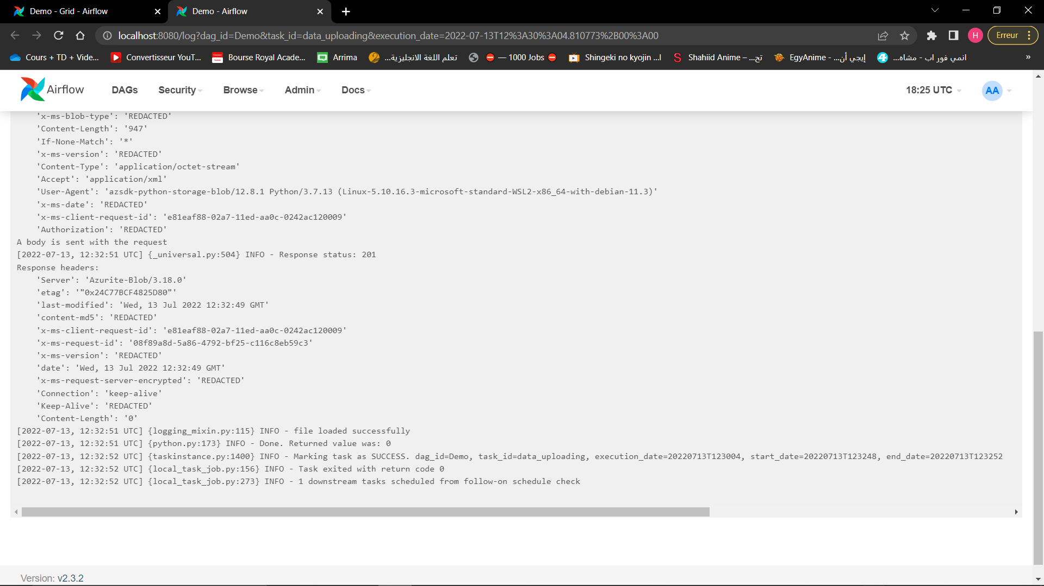
data_uploading_task output

Slide 10
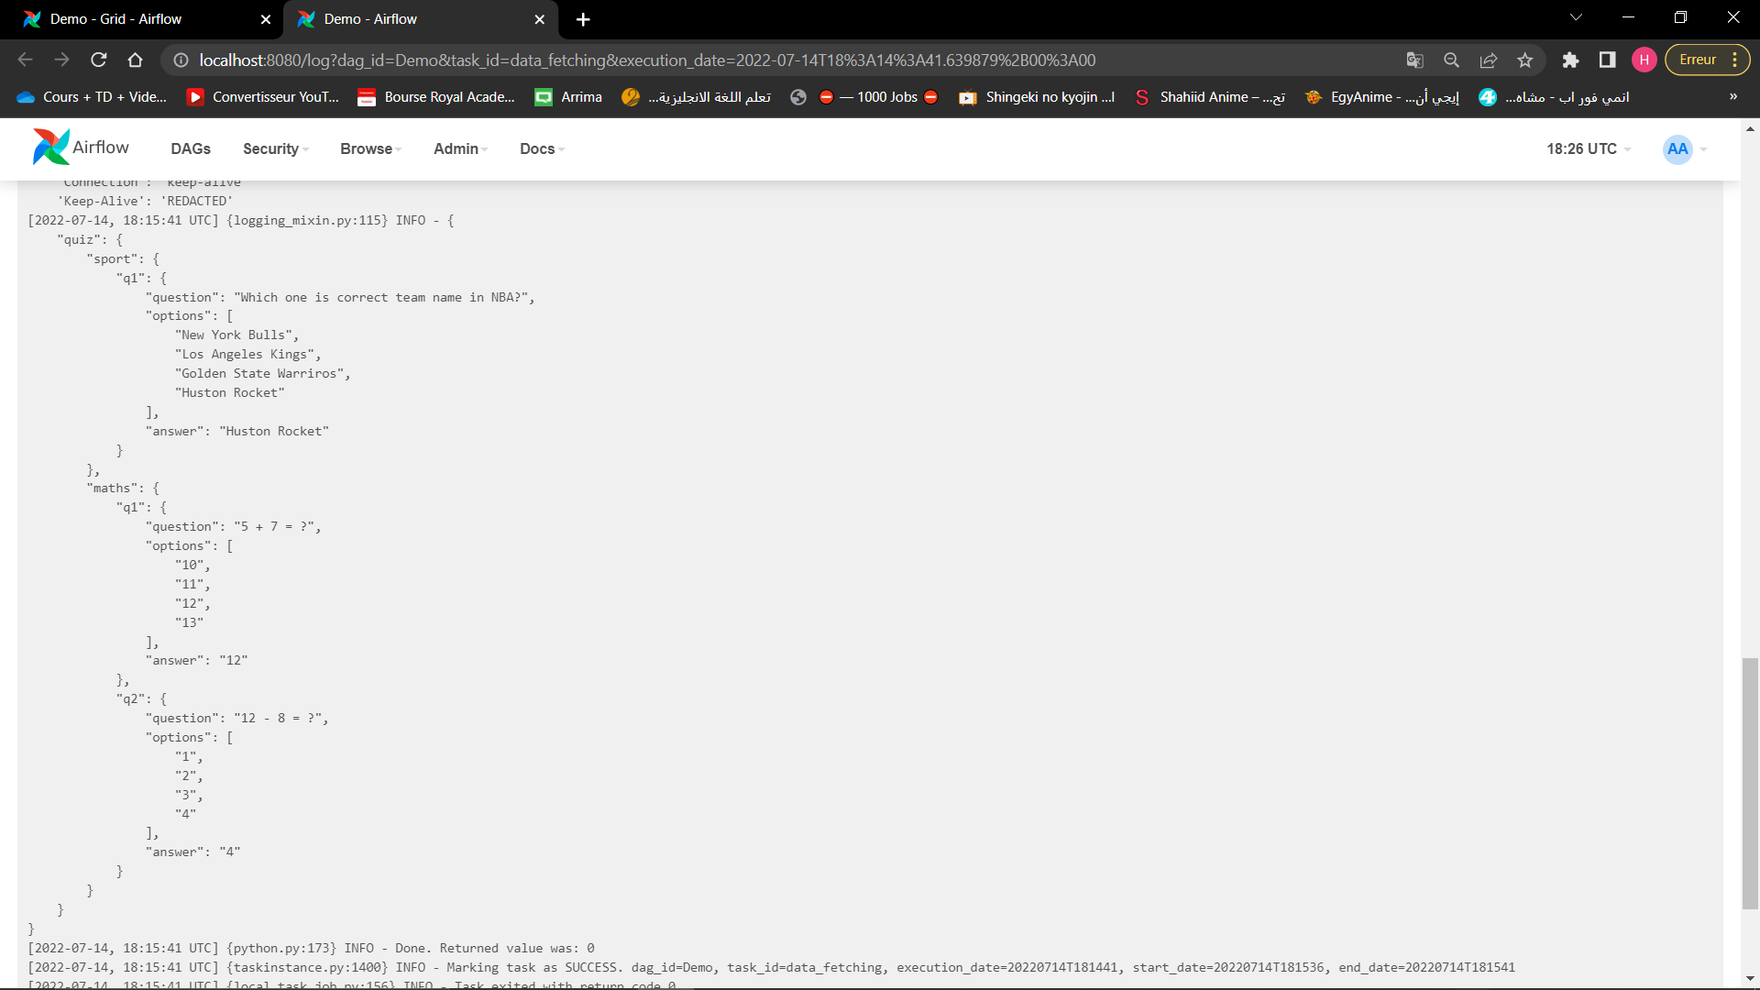
data_fetching_task output

Slide 11
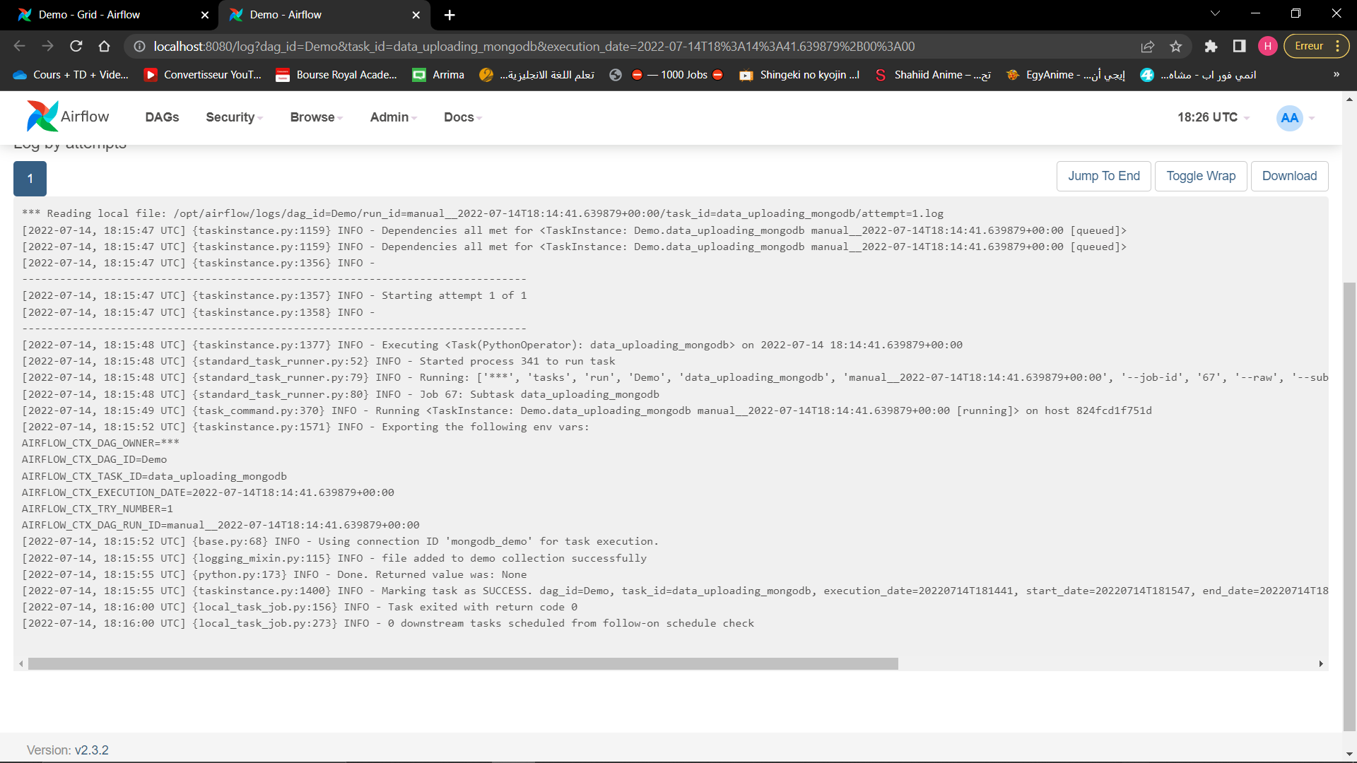
data_uploading_mongodb_task output

Slide 12
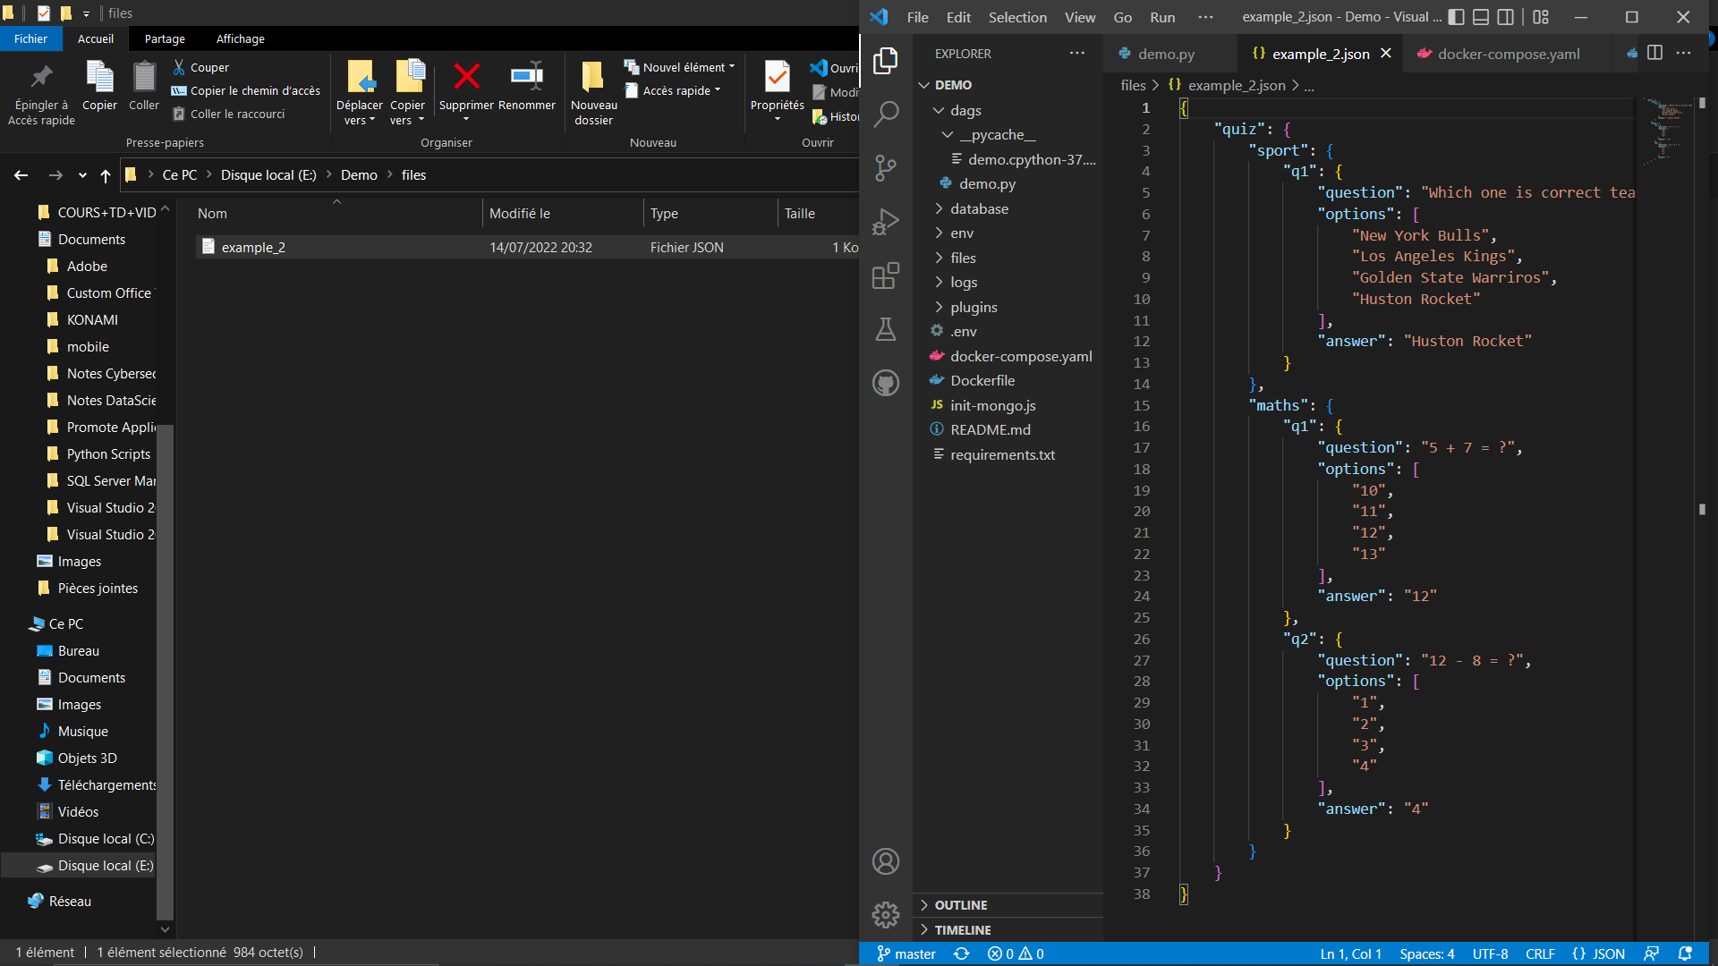
File initial position and content

Slide 13
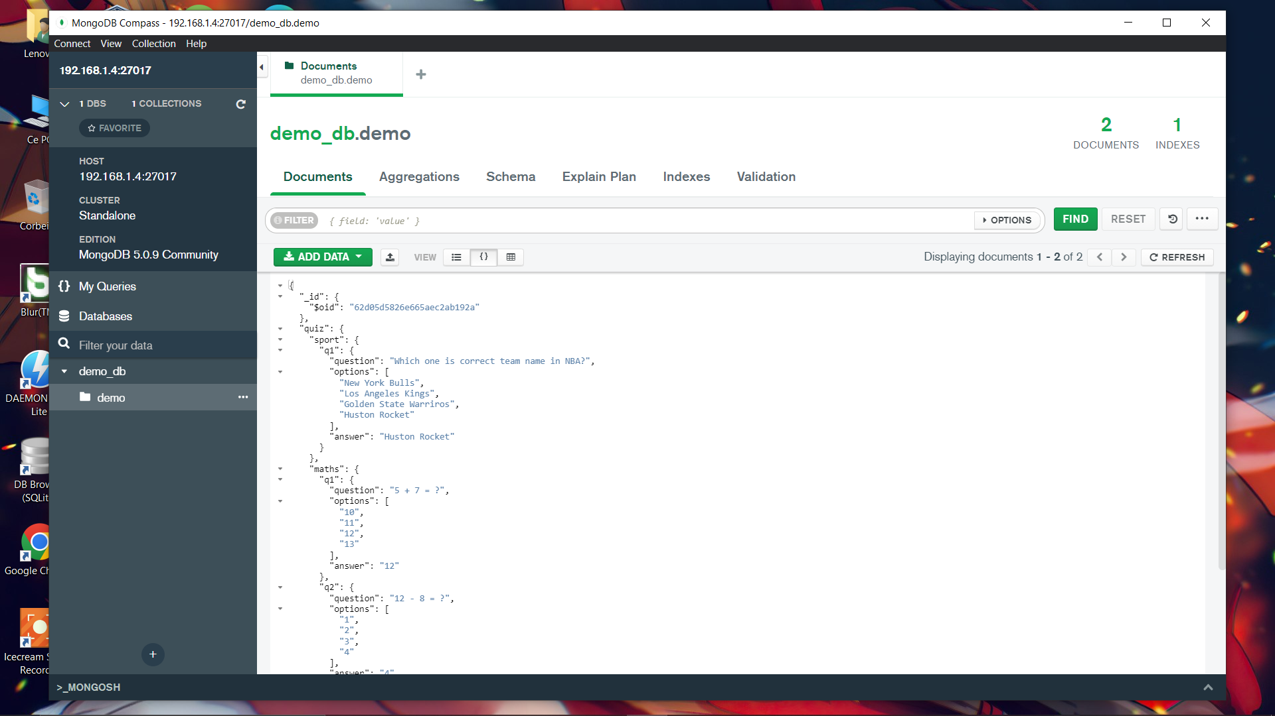
File final position( uploaded to demo_db)

Slide 14
THANK YOU FOR YOUR ATTENTION

